Slide 1
The Power of Body Language
Pedro Fernando Christofoletti dos Santos

Slide 2
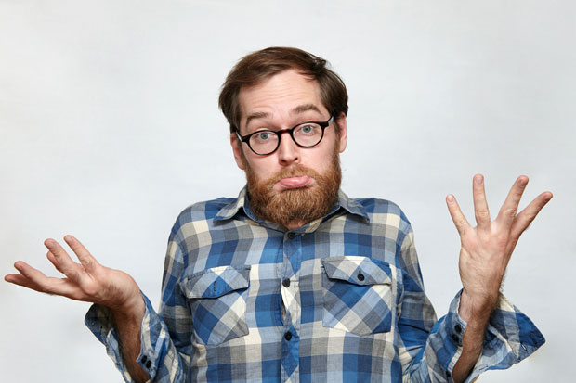
What is body language?

Slide 3
Facial Expressions
Body Proxemics
Ornaments

Slide 4
Decoding and Encoding
Decoding is your ability to read people’s cues. It is how you interpret hidden emotions, information and personality from someone’s nonverbal language.
Encoding is your ability to send cues to other people. This is how you control your personal branding, what first impression you give and how you make people feel when they are with you

Slide 5
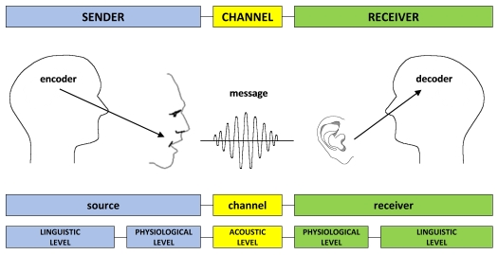

Slide 6
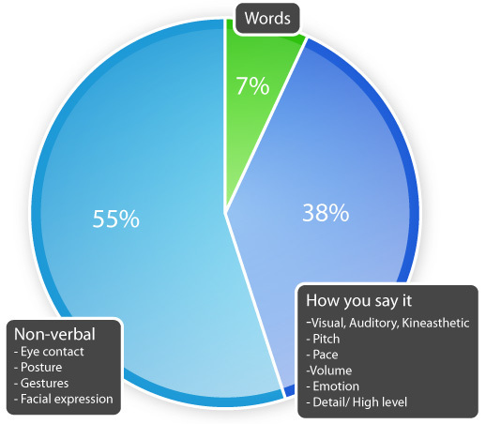
Using without noticing

Slide 7
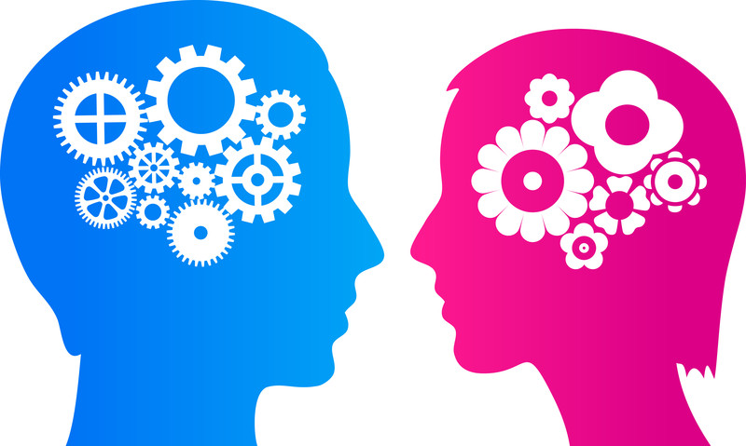
Men vs Women

Slide 8
Men use different areas of their brain to read body language and are not often as good at reading body language as women.
Women have 14 to 16 active brain areas while evaluating others.
Men only have 4 to 6 active ones.

Slide 9

Using it in your favor
Notes:
BY KNOWING HOW TO RECONIZEG BODY LANGUAGE PADERNS IT CAN BE USED IN YOUR ADVANTAGE ANYWHERE ANYTIME

Slide 10
Job interviews
Presentations
Flirting
Arguing
Daily stuff
Demonstrate strength and confidence
Identify whether someone likes you or not
Improve oneself to identify lies

Slide 11
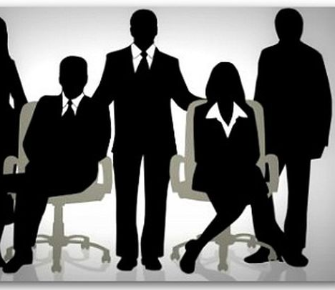
Tips

Slide 12
First impressions are really IMPORTANT, so make sure to give a good one
Good gesturing
Good posture
Firm handshake
Mimic = empaty
Talk with no hurry
Look at the third eye to show power
Control your voice and expressions
Ocuppy space
Visual contact

Slide 13
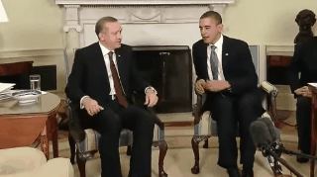

Slide 14
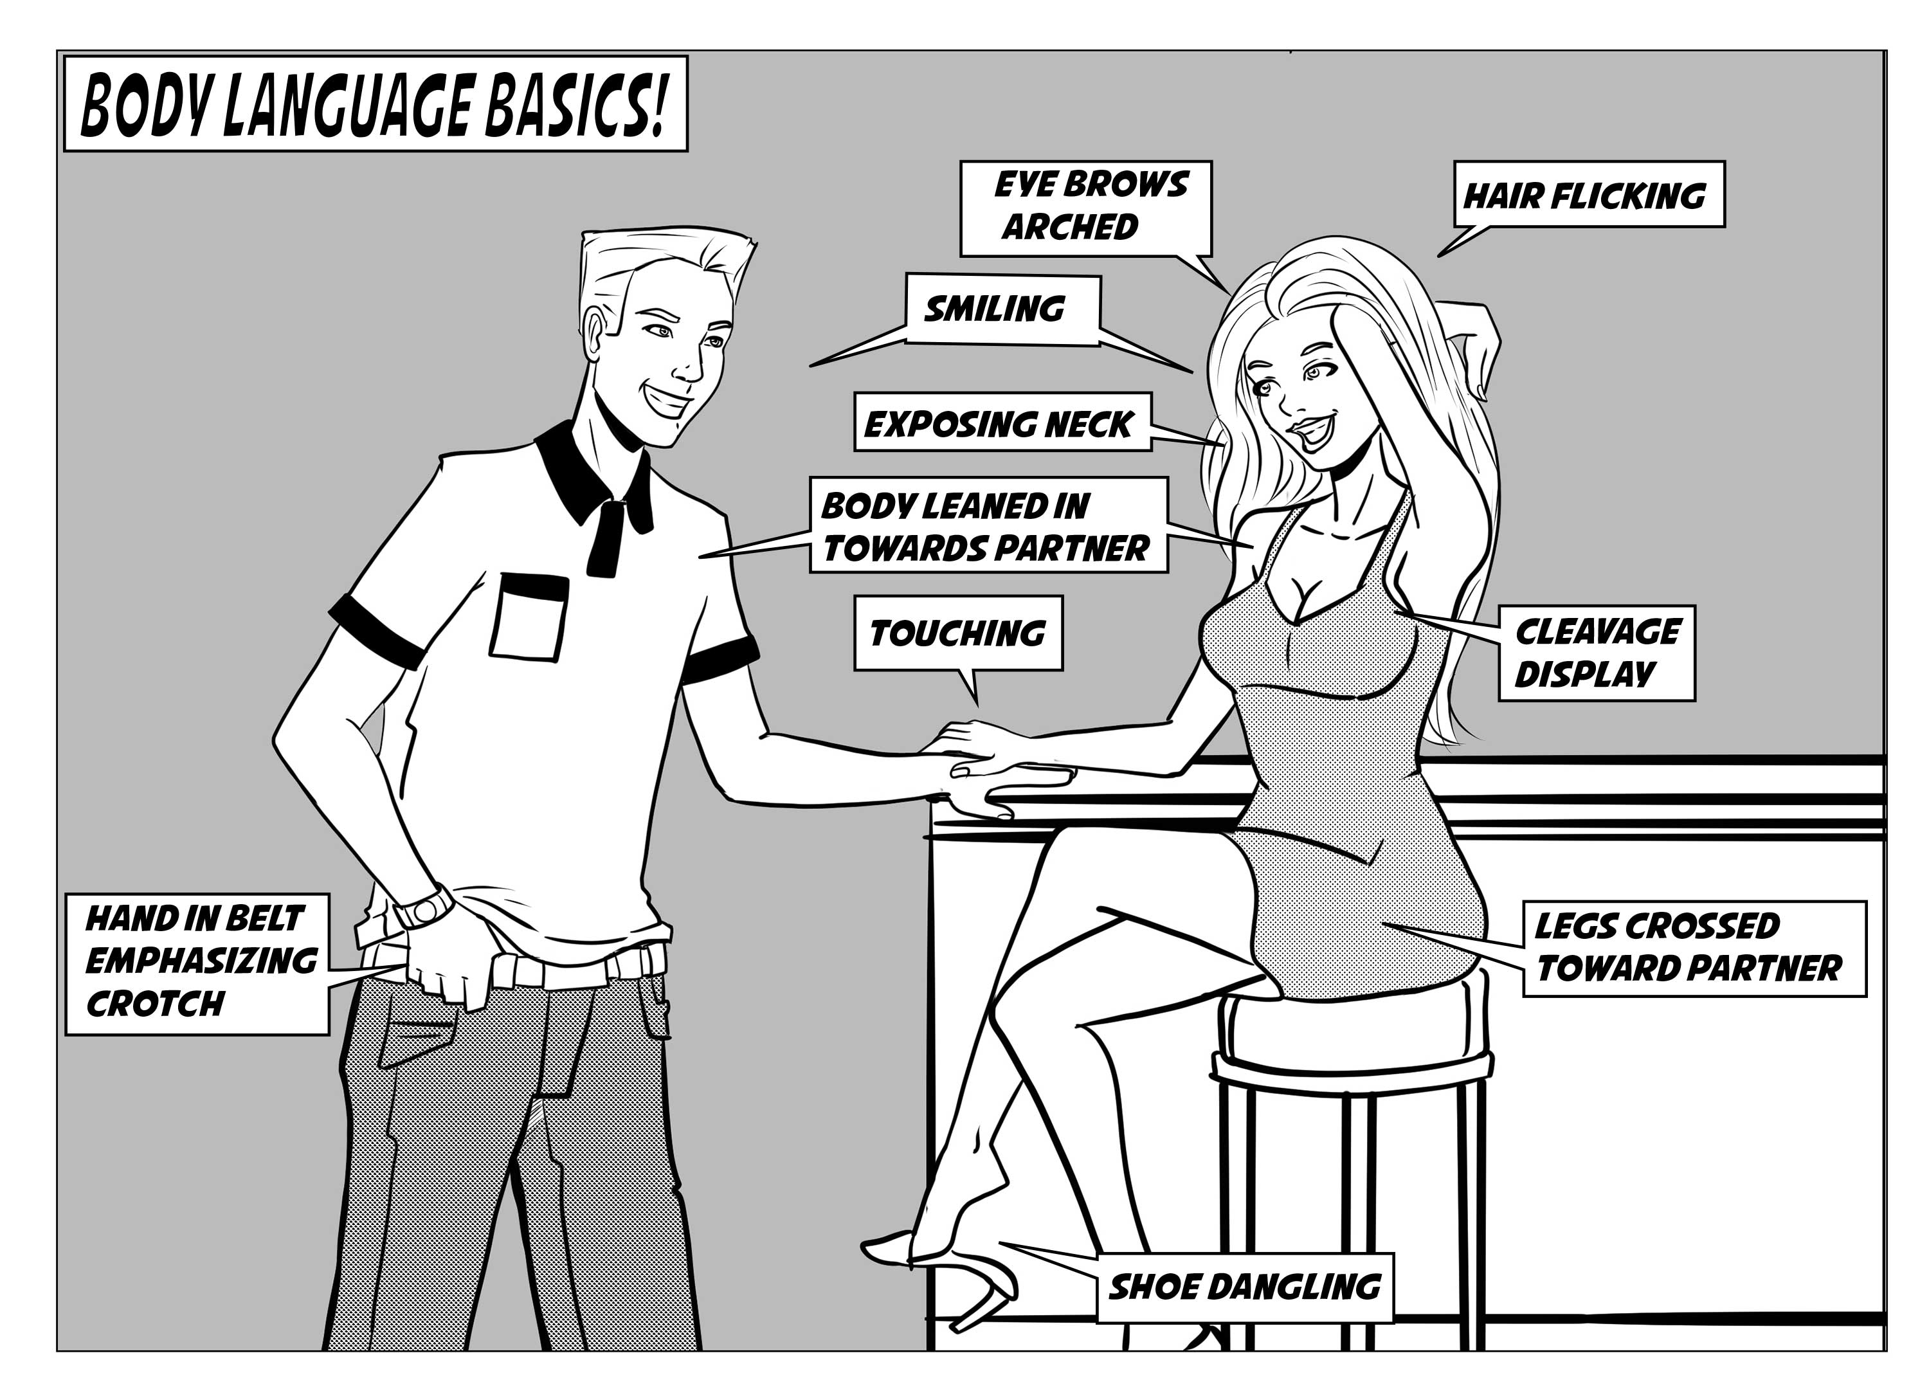
Attraction and Flirting

Slide 15
I’m open
I’m harmless
I’m interested
I’m approachable
I’m fertile

Slide 16
Men
Pointing toes
Showing strength
Touching
Ocuppy space
Men like availability over all else
Men often miss a women’s first courtship signal. On average, women need to eye-gaze three times before a man takes notice.

Slide 17
Women
Tossing the hair
Laughing
Showing neck and wrists (release pheromones)
Wearing red lipstick
Raising eyebrows
Lowering the lips

Slide 18
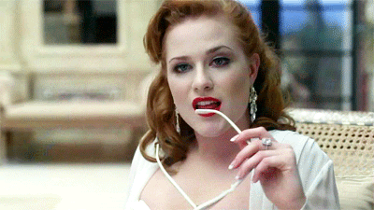

Slide 19
Curiosity
In a study, participants were asked to decode a silent movie. Women were able to guess what was happening 87 percent of the time, but men could guess correctly only 42 percent of the time. Interestingly, homosexual men and men in highly emotional jobs (nursing, teaching and acting) did nearly as well as women.

Slide 20

Lying

Slide 21
Lying cues
NOTE: The body does not lie
To cover the mouth
Avoid eye contact
Compress the mouth
Forehead wrinkles
Inner struggle
Shrink the body
Asymmetrical posture
Keep distance

Slide 22
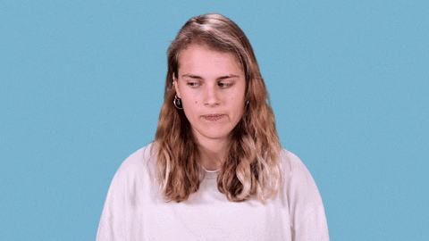

Slide 23
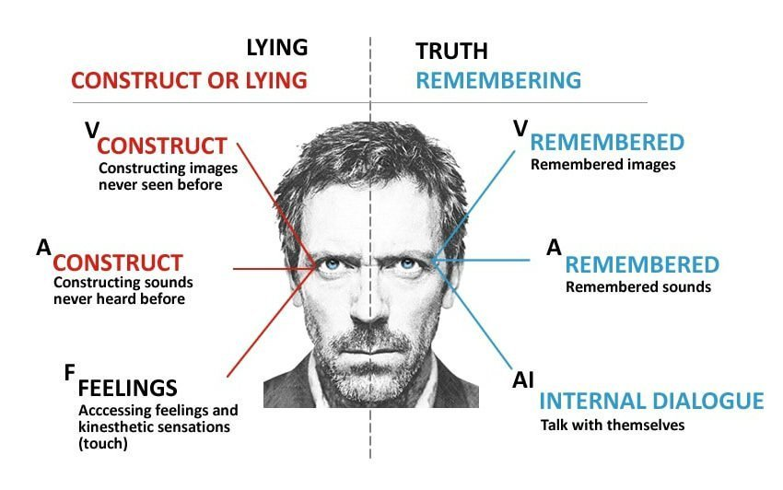

Slide 24
Men and Women lying
Men lie to appear more powerful, interesting, and successful. They lie about themselves eight times more than they lie about others.
Women lie less about themselves and more to protect others’ feelings or to make others feel better about themselves.

Slide 25
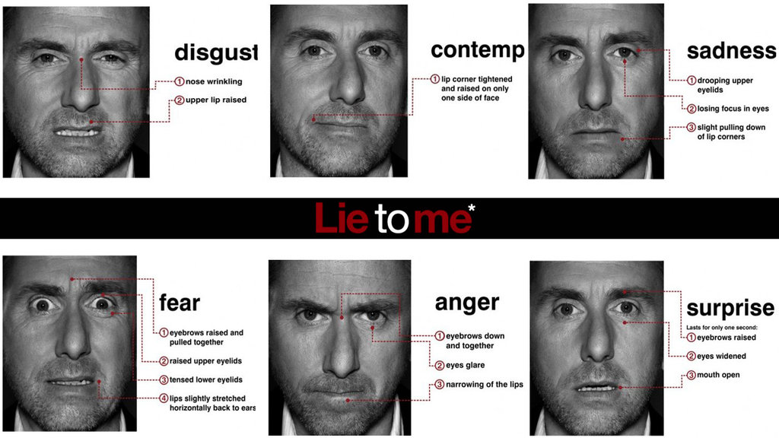
Expressions, face and body
Notes:
NATUARAL OBSERVERS
ABLE TO EVOLV

Slide 26
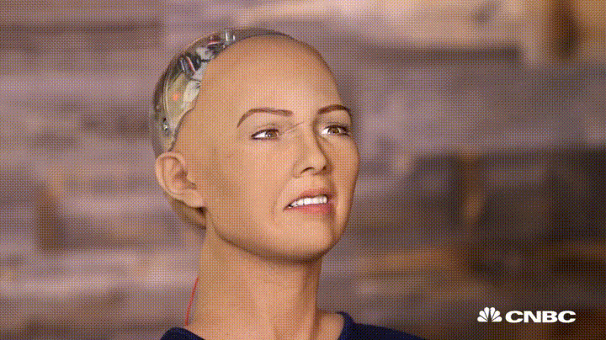

Slide 27

Scare

Slide 28
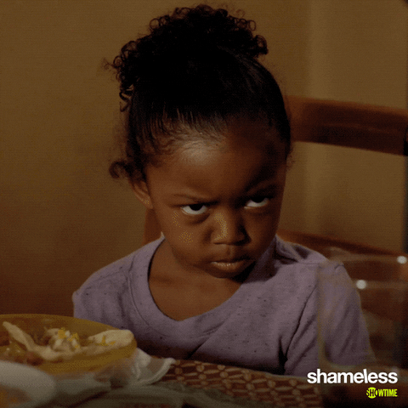
Anger

Slide 29
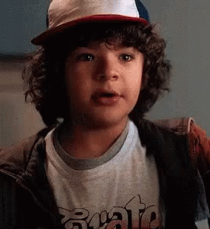
Happiness

Slide 30
Eyes
The eyes are frequently referred to as the "windows to the soul" since they are capable of revealing a great deal about what a person is feeling or thinking.
Rolling the eyes
Pupils dilated
Fully open

Slide 31
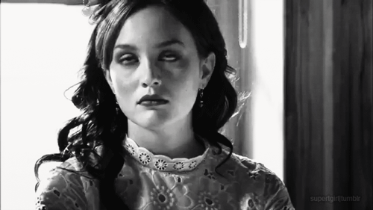

Slide 32
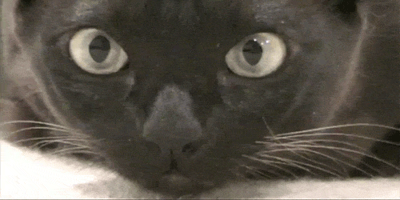

Slide 33


Slide 34
Mouth
Pursed lips: Tightening the lips might be an indicator of distaste, disapproval, or distrust.
Lip biting: People sometimes bite their lips when they are worried, anxious, or stressed.
Covering the mouth: When people want to hide an emotional reaction, they might cover their mouths in order to avoid displaying smiles or smirks.

Slide 35
Arms, legs and Body
MIGHT BE
Crossed arms feels defensive, self-protective, or closed-off.
Standing with hands placed on the hips ready and in control, aggressiveness.
Clasping the hands behind the back might indicate that a person is feeling bored, anxious, or even angry.
Rapidly tapping fingers or fidgeting can be a sign that a person is bored, impatient, or frustrated.
Open posture trunk of the body open and exposed = friendliness, openness, and willingness.
Closed posture hiding the trunk of the body often by hunching forward and keeping the arms and legs crossed = hostility, unfriendliness, and anxiety.

Slide 38
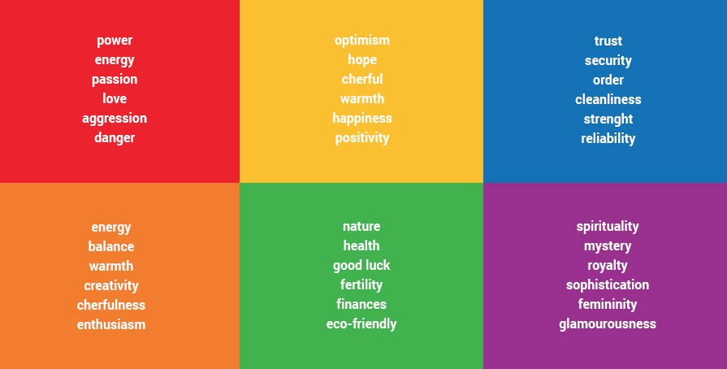
Colors

Slide 39

Leaders body language

